Slide 1
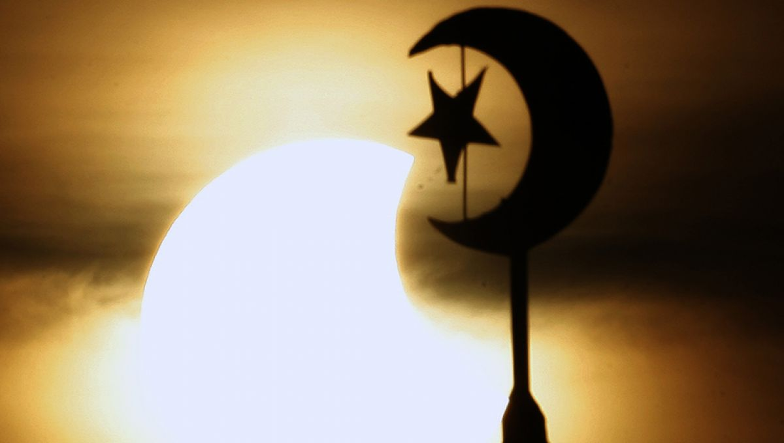
Chapter 5
Vocabulary

Slide 2
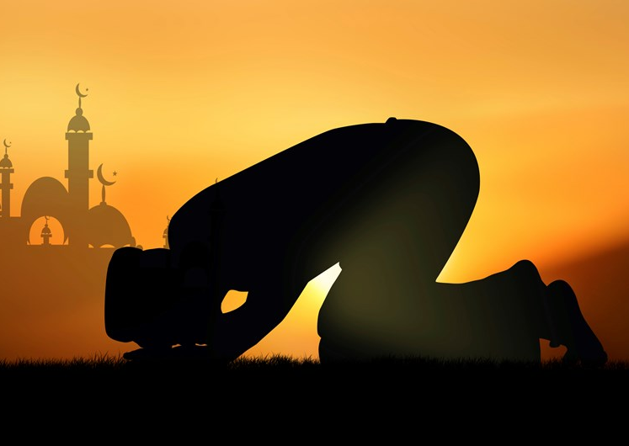
Islam
The religion of Muslims
One God
Allah
Muhammad was the prophet

Slide 3
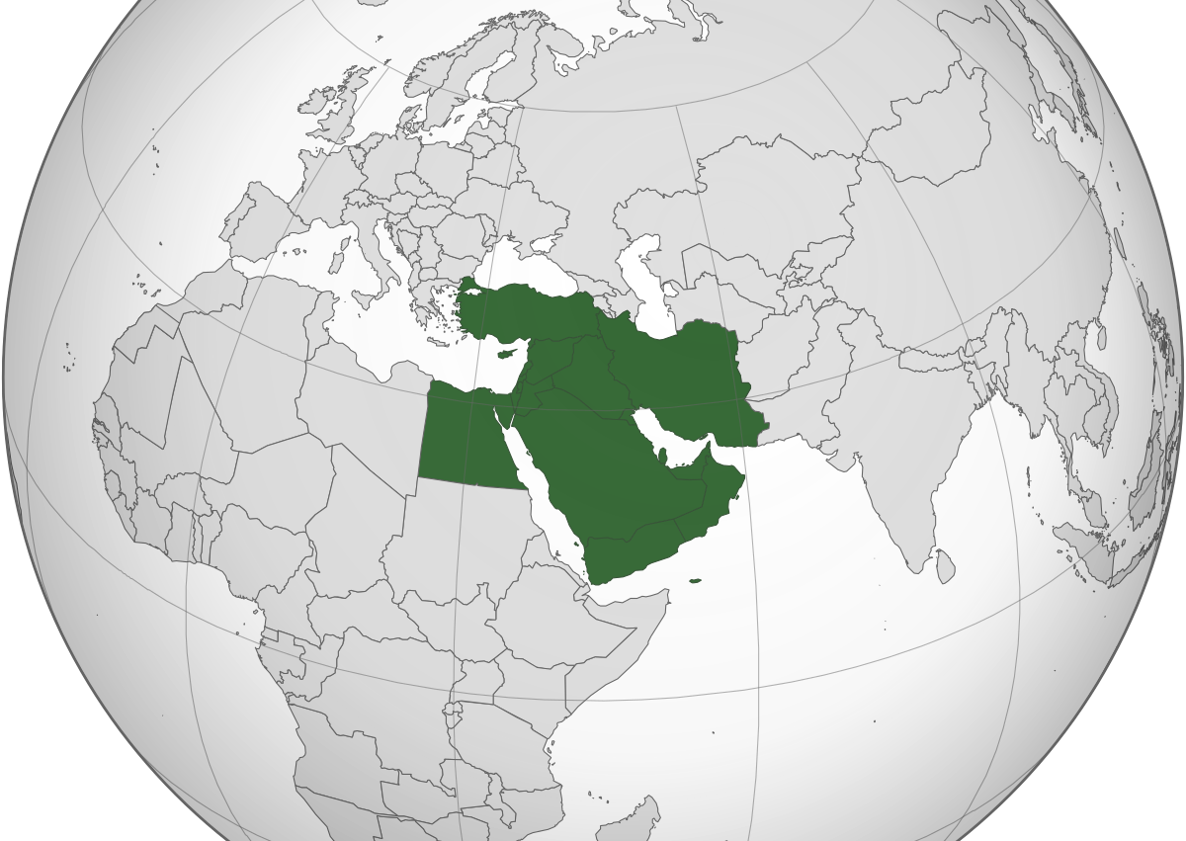
Middle East
Region of the world between Europe and central Asia
Southwest Asia

Slide 4
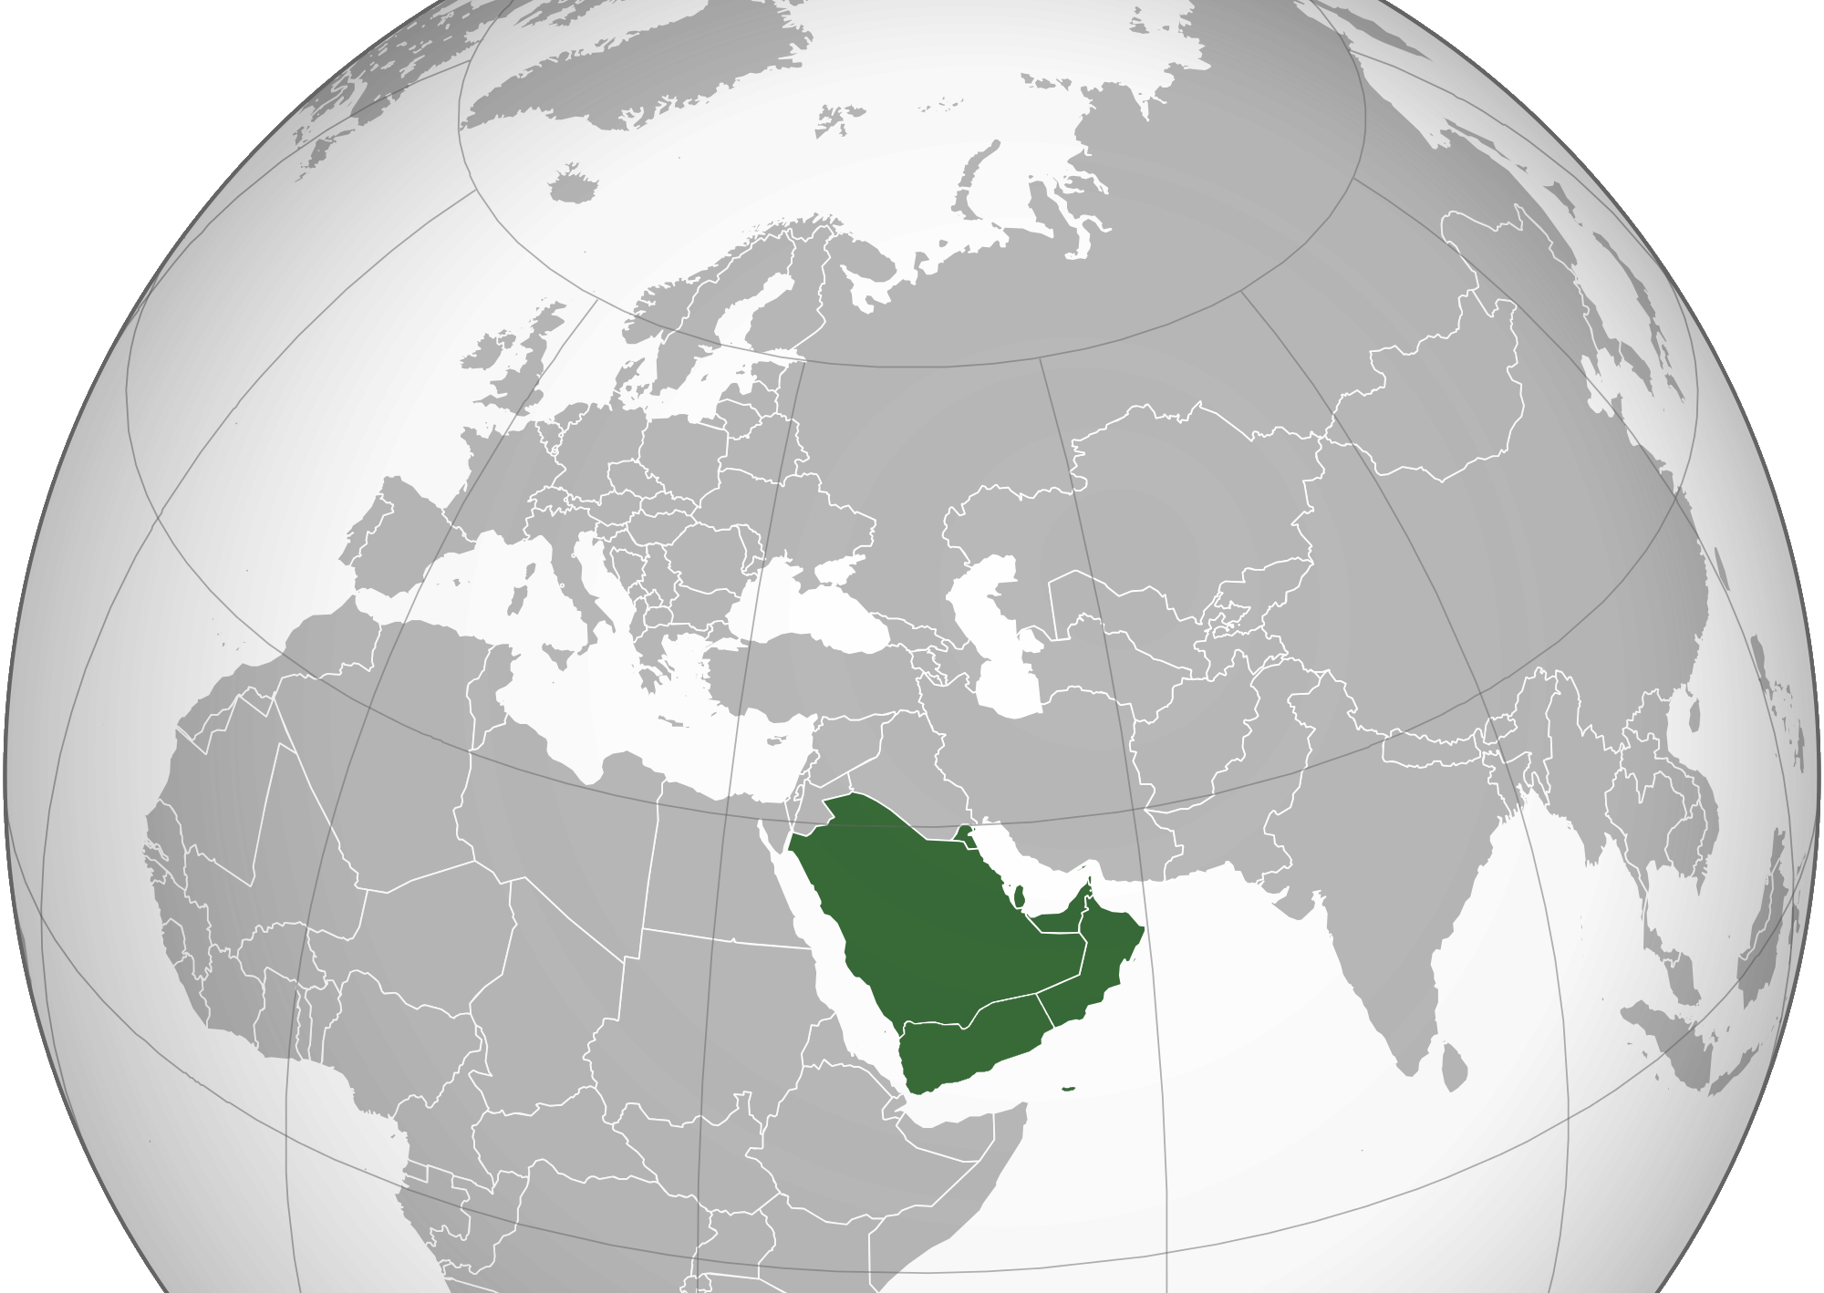
Arabia
The peninsula between the Red Sea and the Persian Gulf
Mostly desert

Slide 5
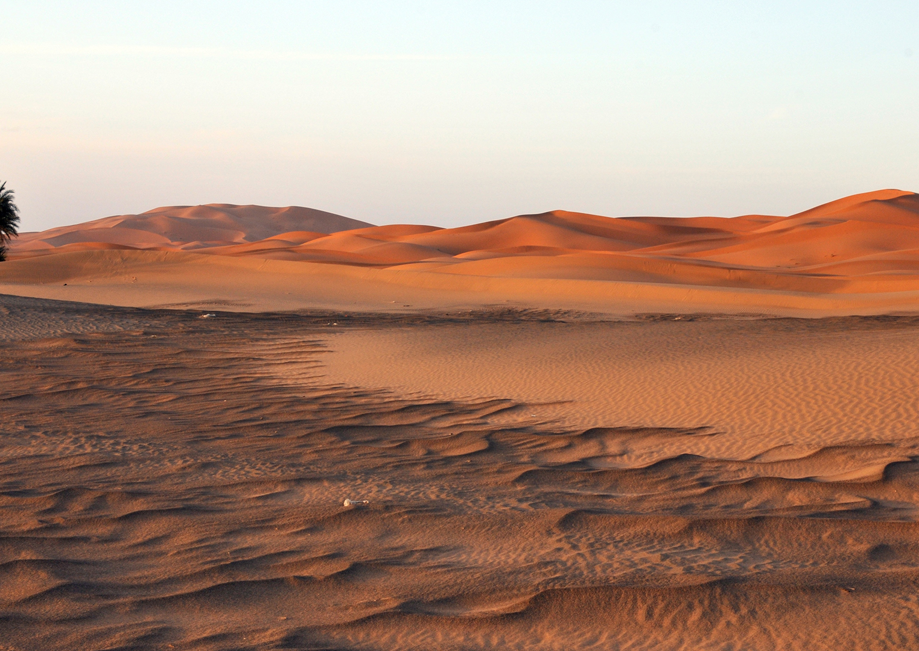
Desert
Very dry regions
Little water
Extremely hot or cold

Slide 6
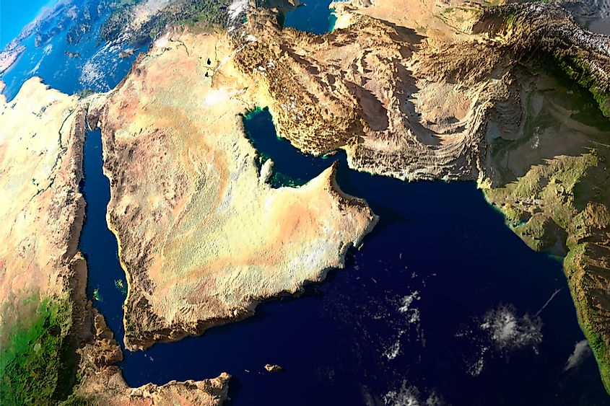
Peninsula
Water on most of its borders

Slide 7
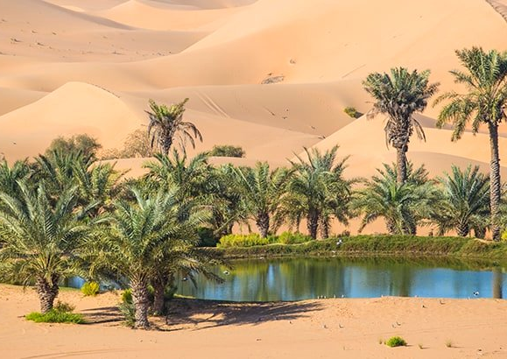
Oasis
Fertile areas of land in the desert

Slide 8
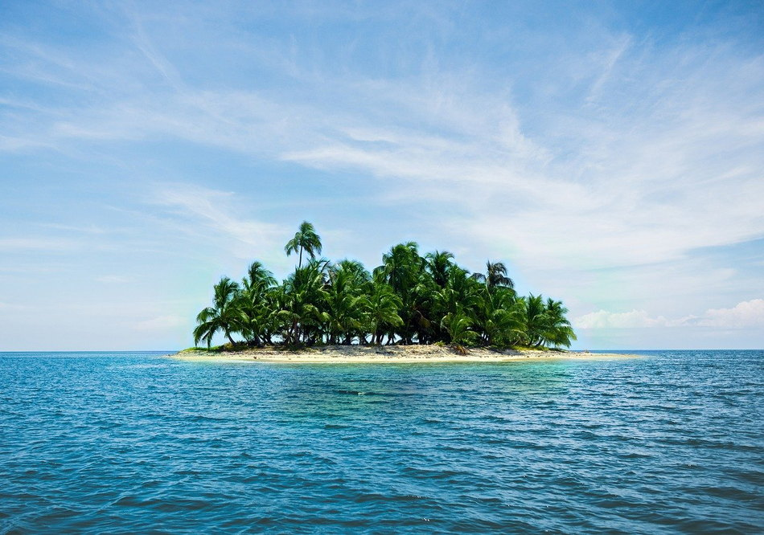
isolation
To be away from others

Slide 9
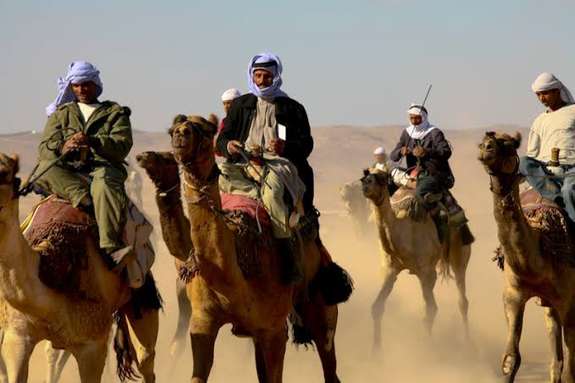
Nomads
People who move from place to place

Slide 10
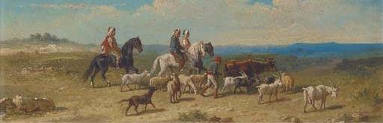
Herders
People who follower and raise herds of animals

Slide 11
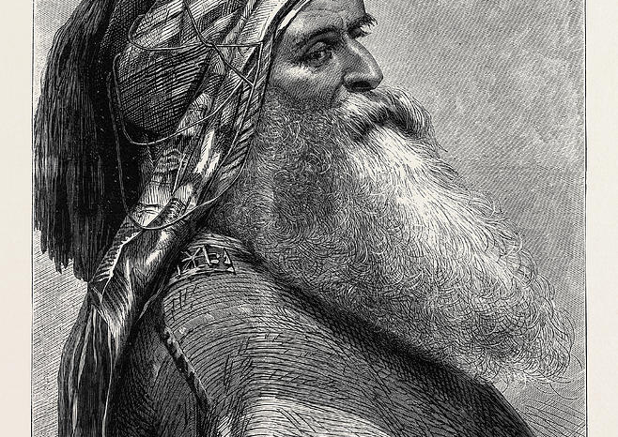
Sheikh
Leaders of early Arabs tribes

Slide 12
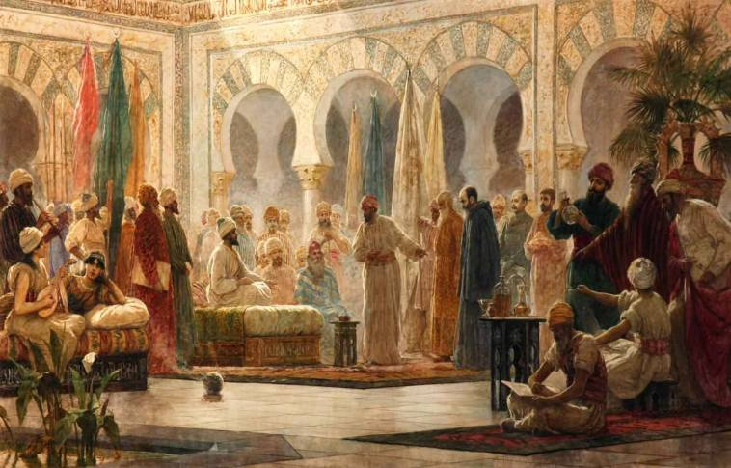
Arab
Originally a person from Arabia
Eventually refereed to anybody who spoke the Arabic language or living in Arab lands

Slide 13
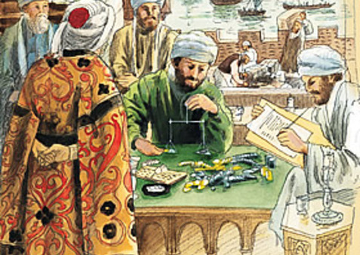
Merchants
People who buy and sell items

Slide 14
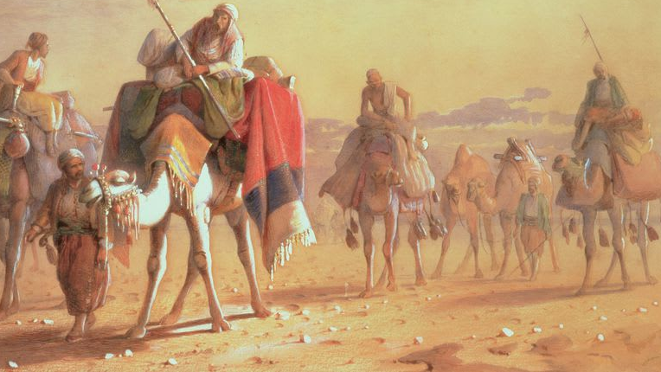
Caravans
Travelling merchants
Travelled together for protection
Travelled along trade routes
Silk Road and Trans-Sahara trade route

Slide 15
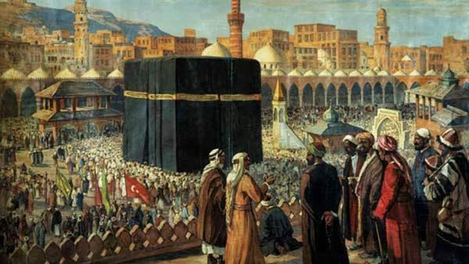
Mecca
City in Arabia
Home of Muhammad
Holy city of Islam
Kaaba located there

Slide 16
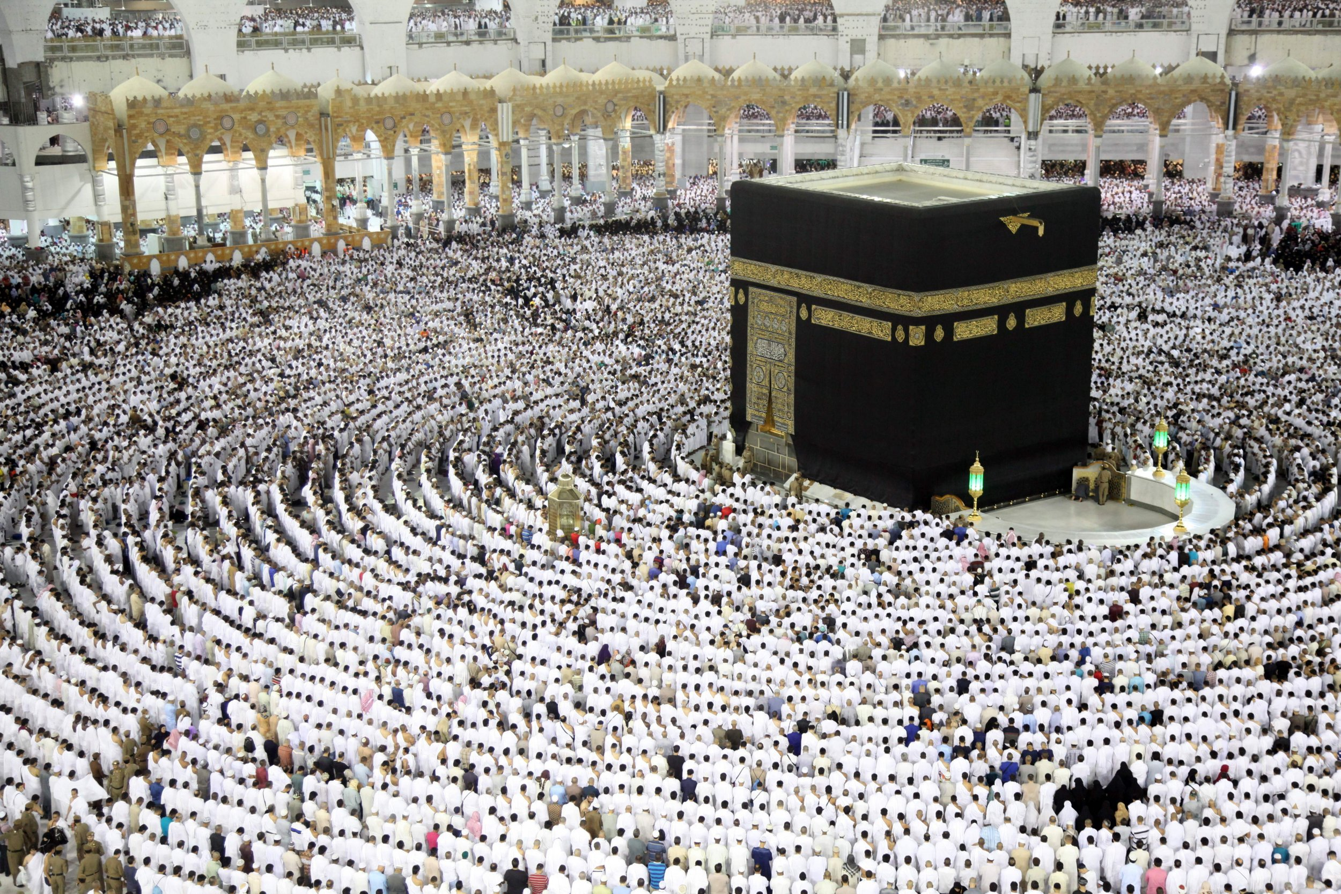
Kaaba
Religious relic
Located in mecca
Muslim worship there

Slide 17
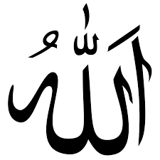
Allah
God in the Arabic language

Slide 18
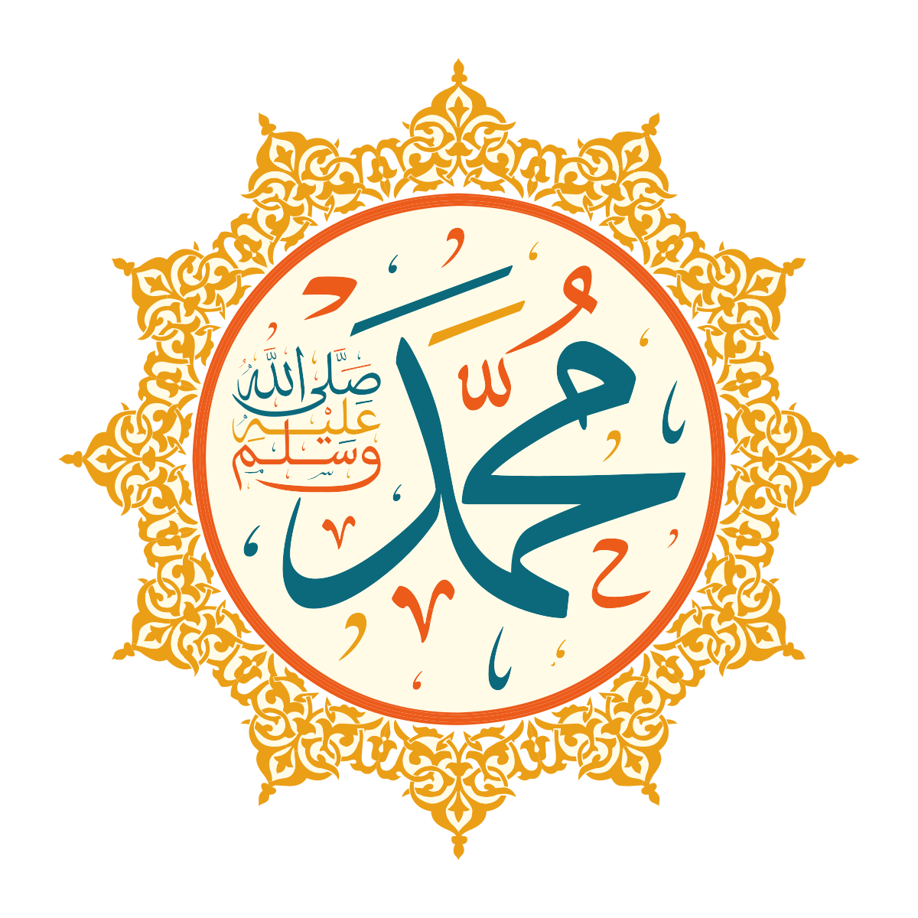
Muhammad
The prophet of Islam
Lived in Arabia

Slide 19
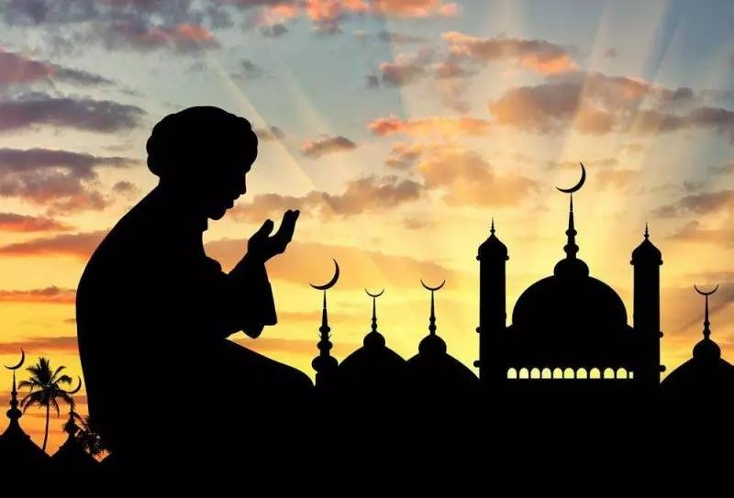
Muslims
Followers of Islam

Slide 20
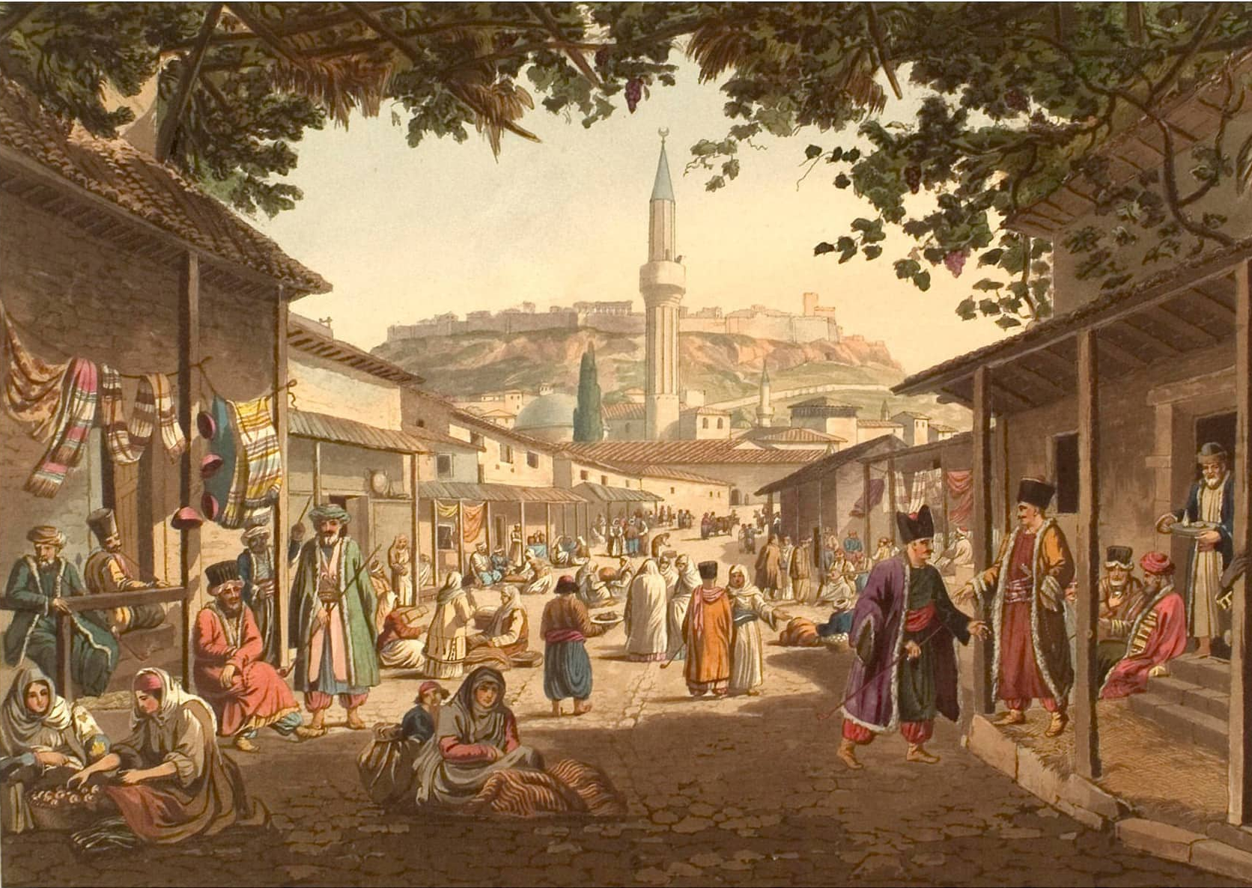
Madinah
The city Muhammad fled to when he was forced out of Mecca

Slide 21
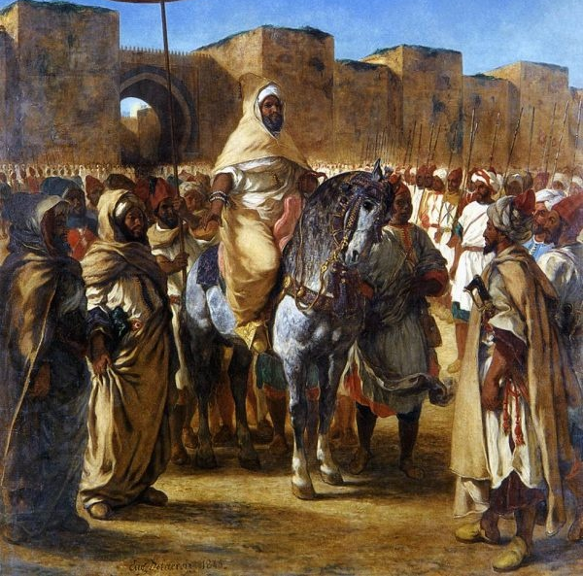
Islamic state
A territory where the government is based on Islamic law
Theocracy – government and religion are the same

Slide 22
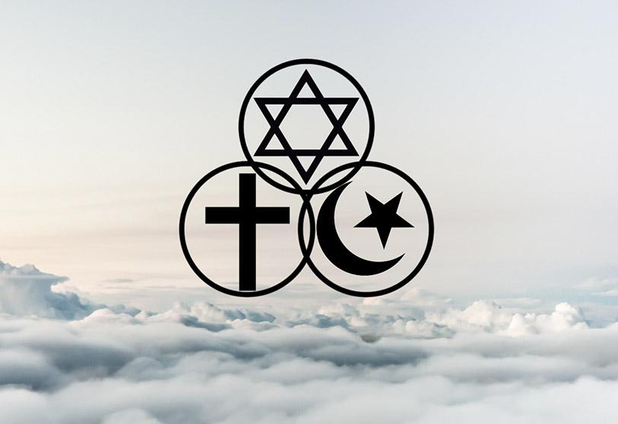
Monotheism
The belief in one god

Slide 23
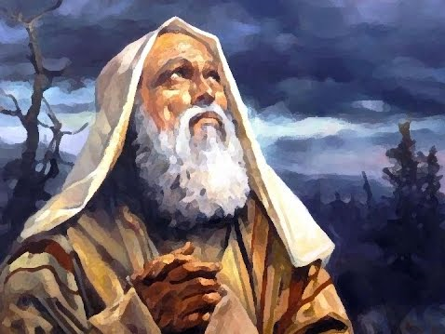
prophet
A messenger from God

Slide 24
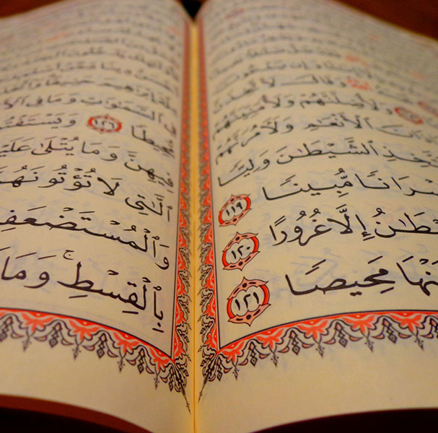
The Quran
The holy teachings that Muhammad told his follows
Islam’s holy book

Slide 25
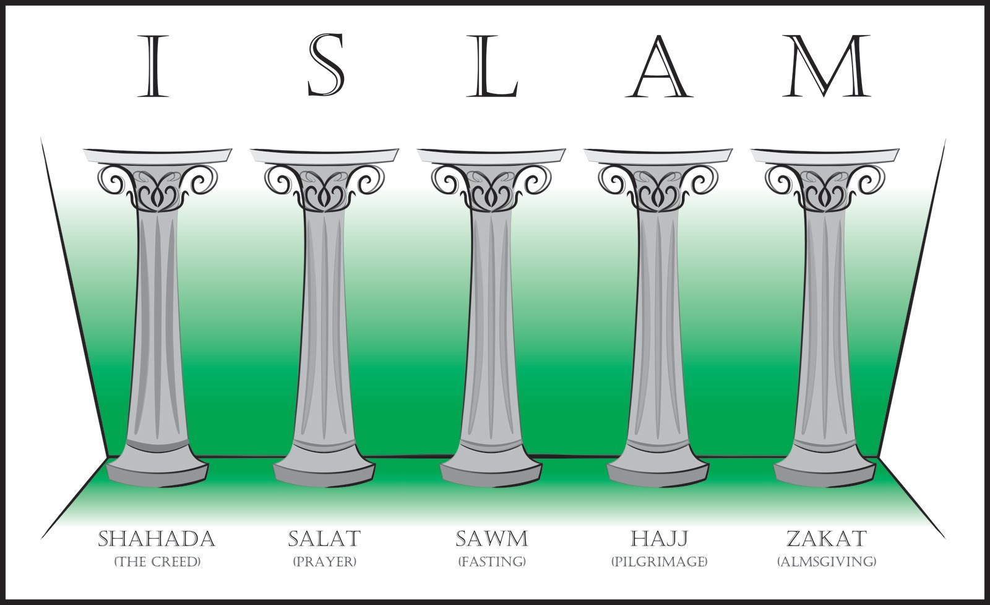
The Five Pillars
Declaration of one god
Fasting
Prayer
Charity
Trip to Mecca

Slide 26
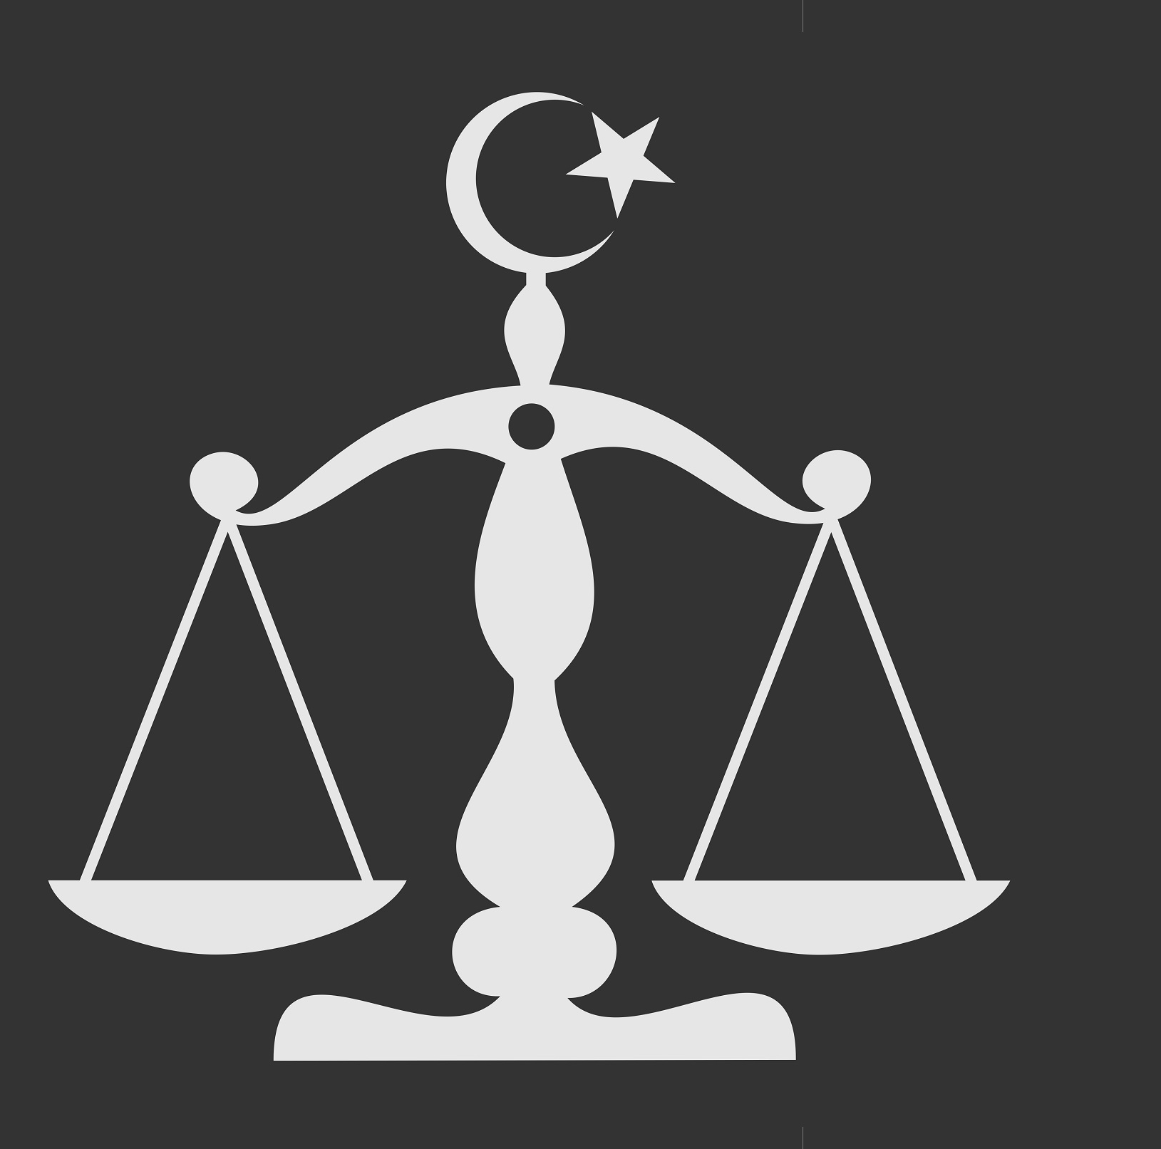
Shariah law
Laws based on Islamic teachings
Foundation for Islamic states

Slide 27
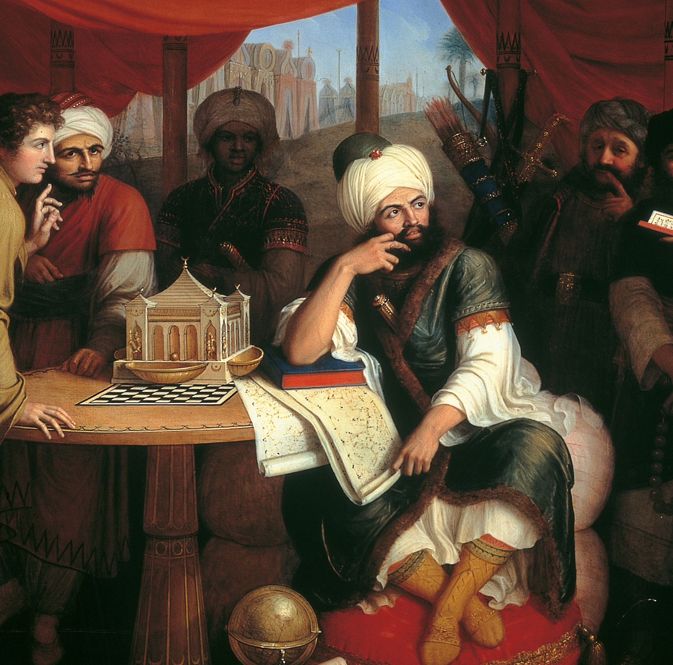
Caliph
The leader of Islam

Slide 28
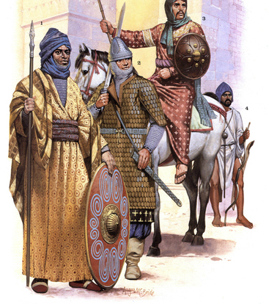
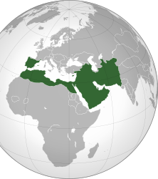
The Umayyads
Early group of caliphs that expanded Islamic influence in the Middle East

Slide 29
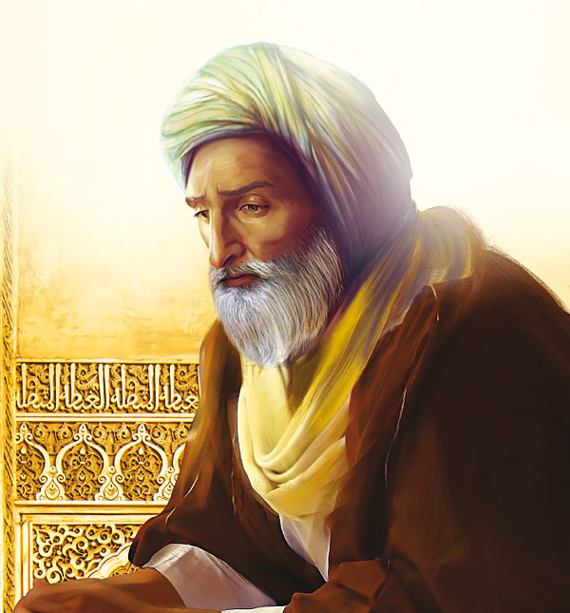
Ibn Rushd
Muslim explorer

Slide 30
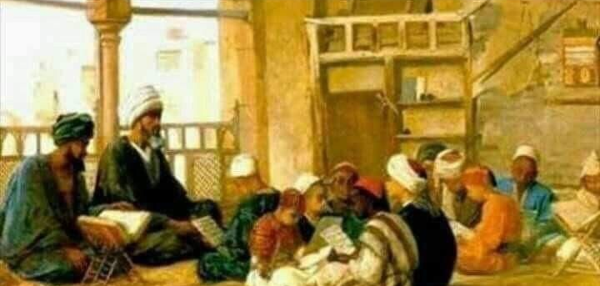
Sufis
Muslim missionaries

Slide 31
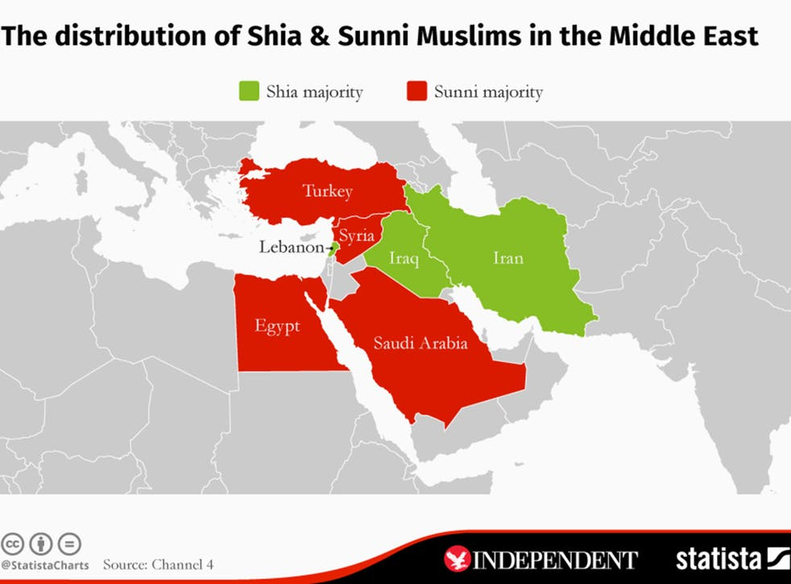
Sunni
Muslims who believe the Caliphs do not have to descend from Muhammad’s family

Slide 32
Shia
Muslims who believe the Caliph must be a descendant of Muhammad

Slide 33
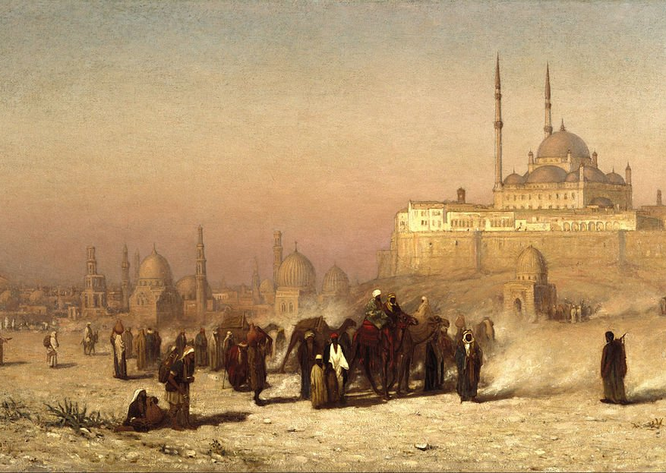
Abbasid Empire
Muslim empire that controlled parts of North Africa, the Middle East and central Asia
800-1200

Slide 34
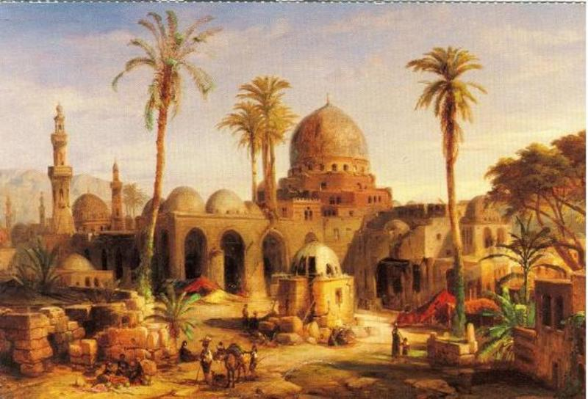
Baghdad
The capital city of the Abbasid Empire

Slide 35
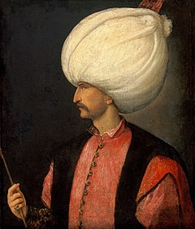
Sultan
The title given to the Ottoman rulers

Slide 36
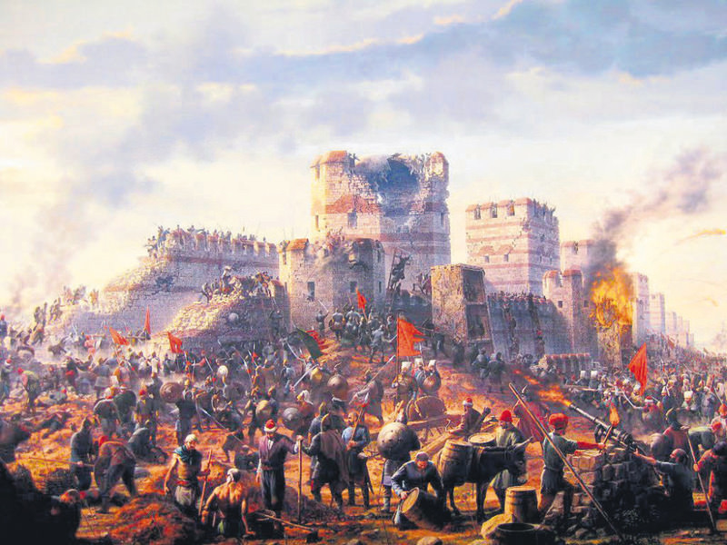
Ottoman Empire
The empire that originated from Turkey and conquered the Byznatine Empire
Sacked the city of Constantinople
Mehmet II and Suleiman were its most famous rulers

Slide 37
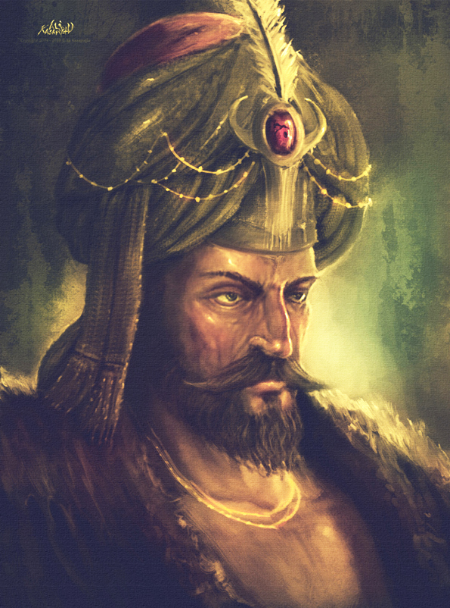
Mehmet II
Also known as Mehmet the conqueror
Leader of the Ottoman empire when it destroyed the Byzantine empire

Slide 38
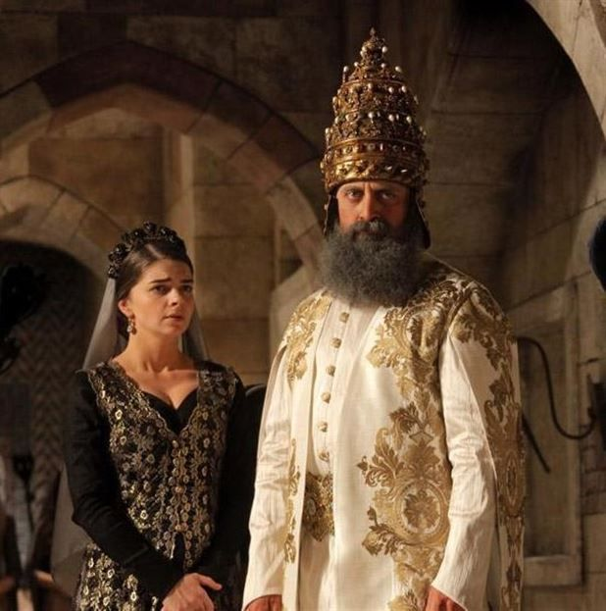
Suleiman the Great
Ruler of the Ottoman empire in the 1500s
Organized laws and built many school and mosque throughout the empire

Slide 39
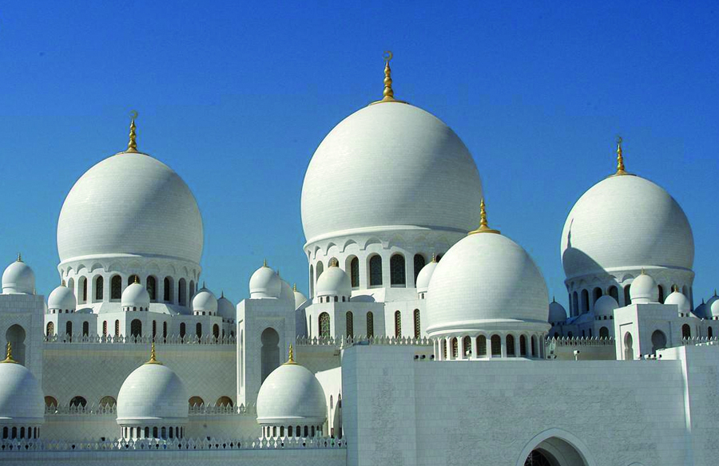
Mosque
Holy place of worship for Muslims

Slide 40
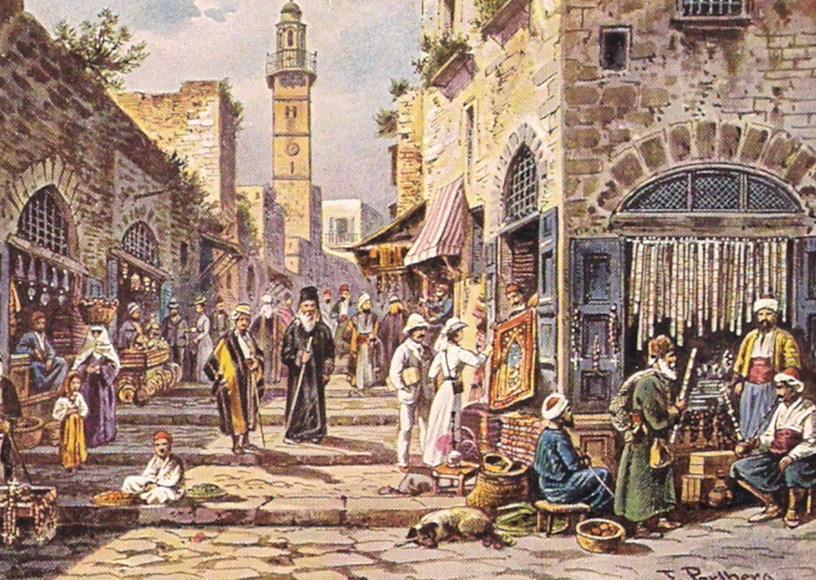
Bazaar
Marketplace in the Muslim world

Slide 41
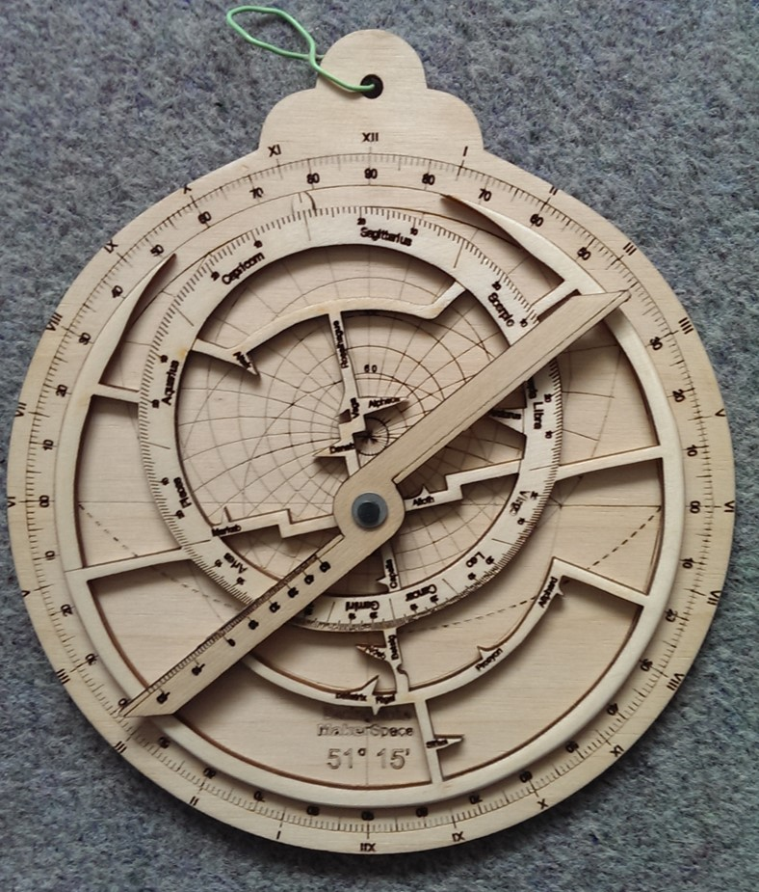
Astrolabe
A device used to locate distance and direction to pinpoint location on a map

Slide 42
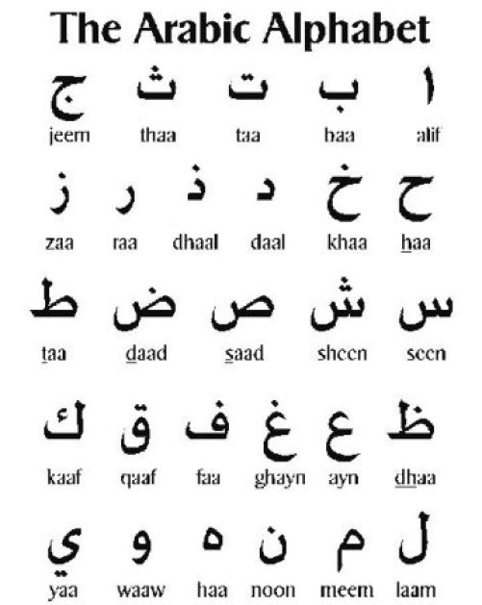
Arabic language
The language spoken by most of the Muslim world during the middle ages

Slide 43
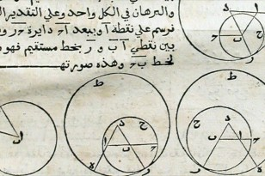
Algebra
A type of math that uses equations to solve for solutions

Slide 44
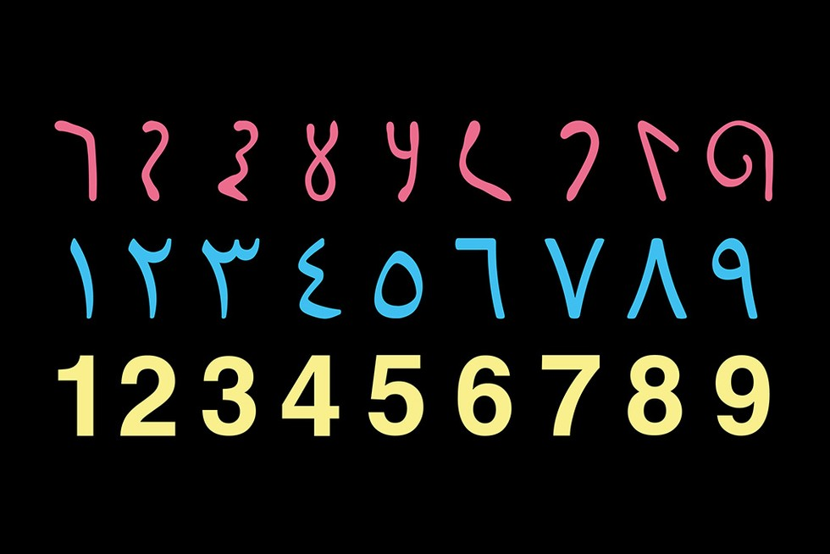
Hindu – Arabic Numerals
Number system used by most of the world today
0-9 integers

Slide 45
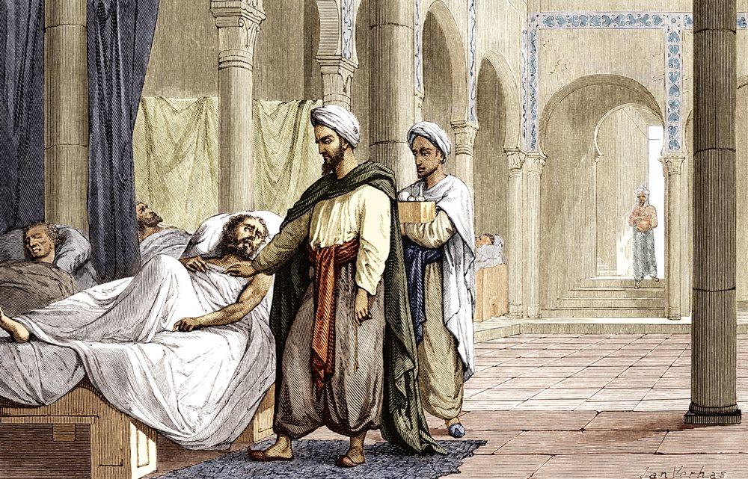
Medicine
Treatments used to help with sickness
Books were published to help prevent sickness
Schools taught medicine to educate doctors

Slide 46
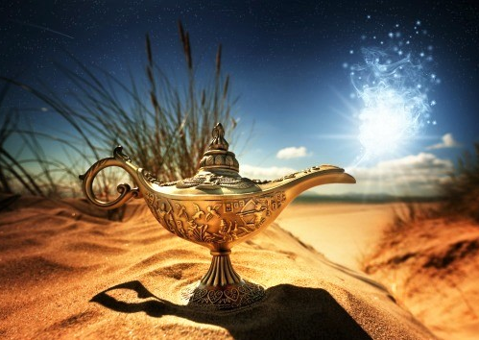
The Thousand and One Nights
Famous Arabic stories
Aladdin is one of the stories in this collection

Slide 47
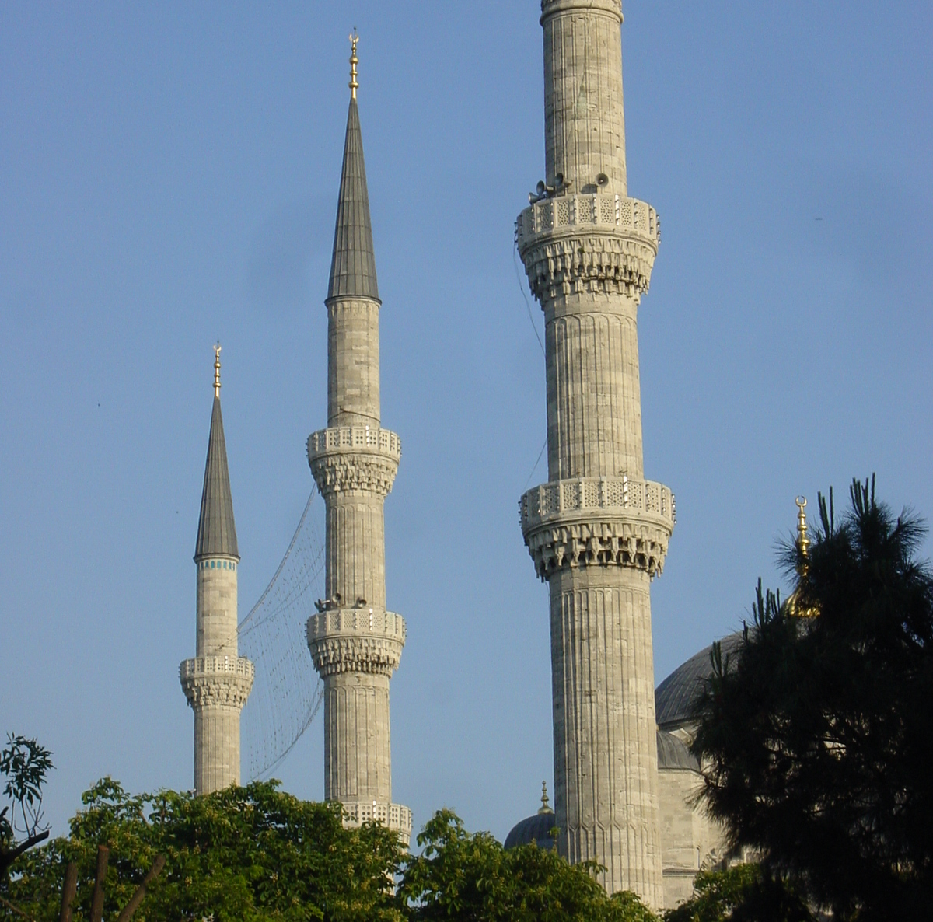
Minarets
Prayer towers at Muslim mosques

Slide 48
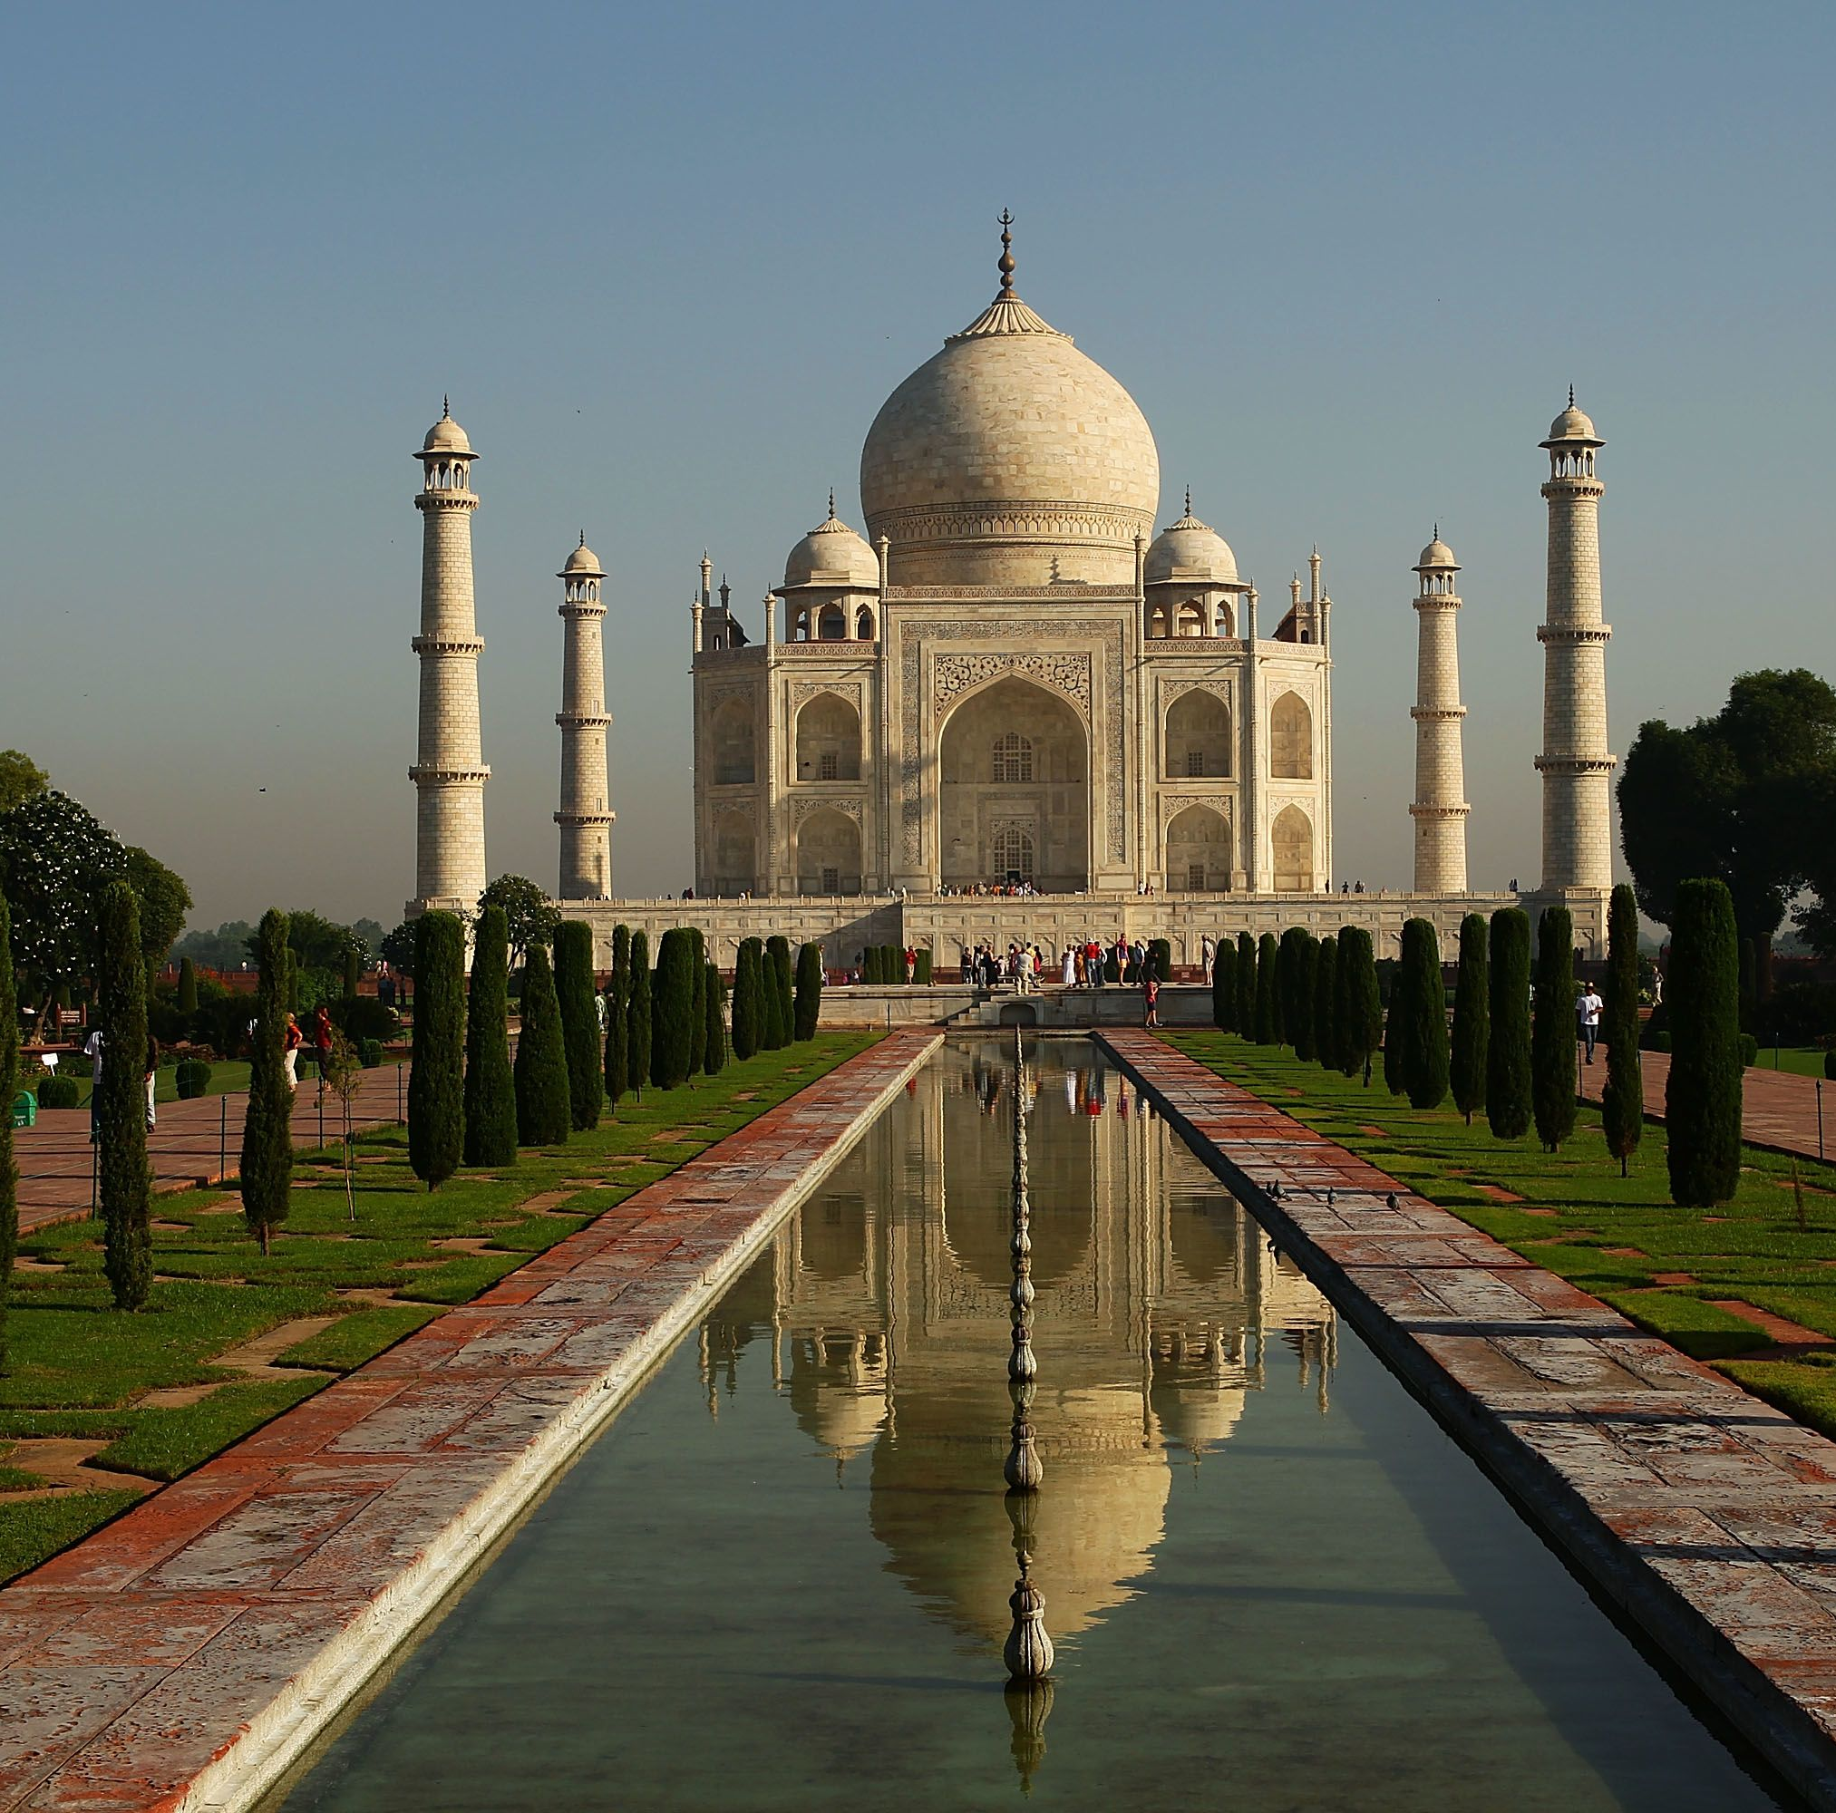
Taj Mahal
Most famous example of Muslim architecture

Slide 49
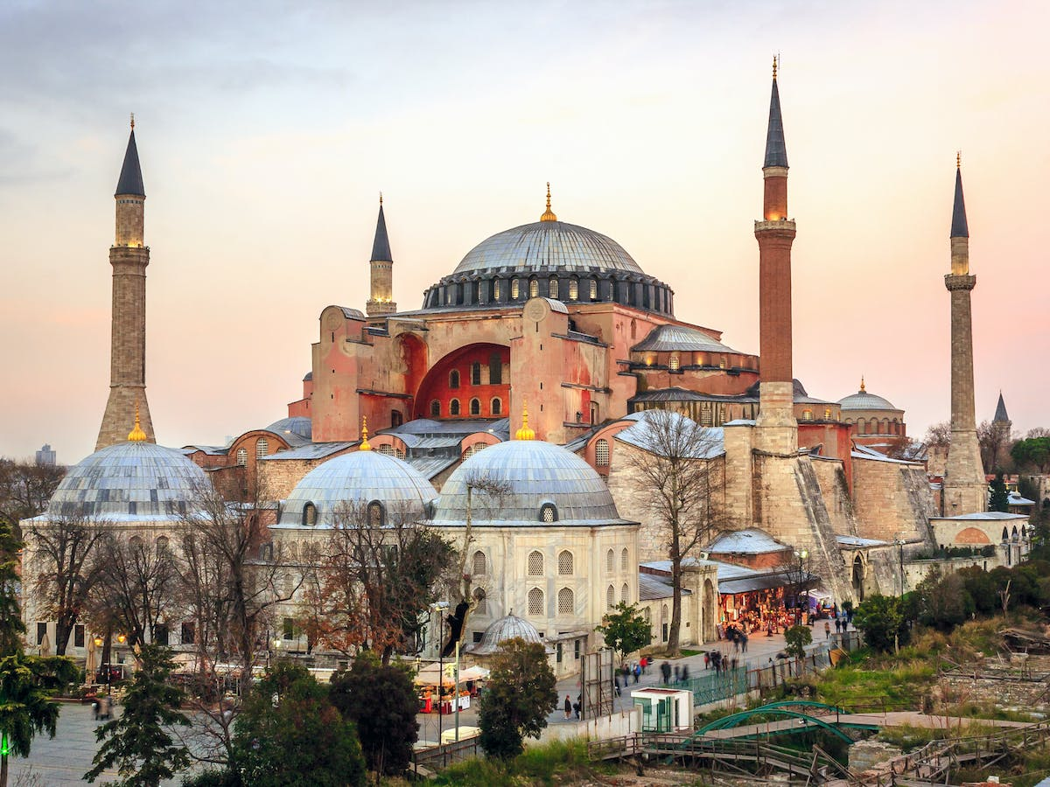
Hagia Sophia
Example of European and Muslim architecture
Was originally a church, then later a mosque

